Slide 1
EPO SDAM NLP PoC Status presentation
April 8th , 2024

Slide 2
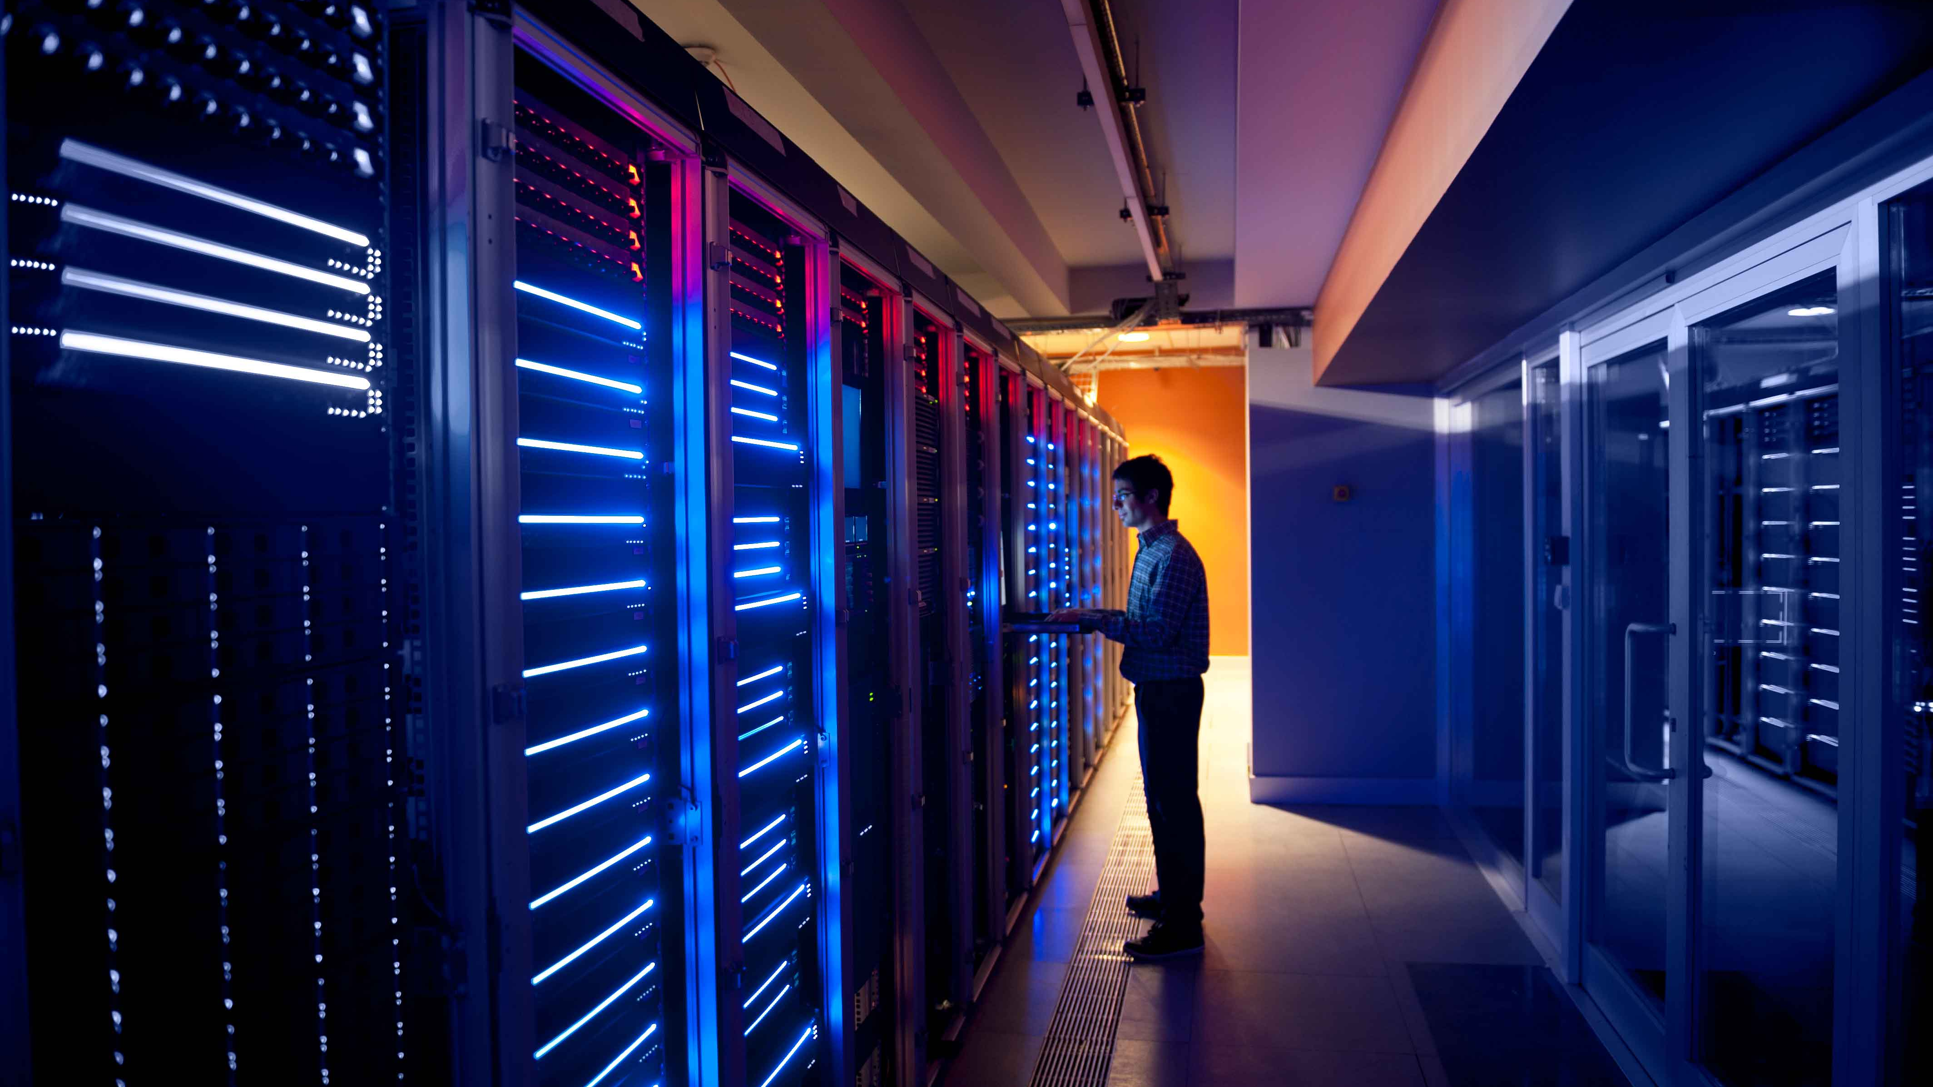

Content
Current status
Rodmap
Risks and dependencies

Slide 3


1. Current status
Starting Date | 04/03/2024
End Date | 12/04/2024
Overall status
Status explanation:
Correct progress.
Done – since last reporting:
Template tried to create a python wheel, but the repo cannot publish python packages. Trying with docker approach now. Reviewing with Edoardo.
Manage the POC like a template, comment with Alejandro about our analysis
Next steps:
Multi-agent to provide Natural Language answers
Work with existent datasets, creating template for connections. For example, test a new connection for VDS in Dremio.
Working with more than one datasets
Bring solution to production environment
Web apps
Required decisions:
Migrate to OpenAI 4? It will mean to migrate to Sweden Region in Azure. Analise impact (cost & approvals).
Status meeting once a week (Monday 3PM)
3

Slide 4
Roadmap

Slide 5
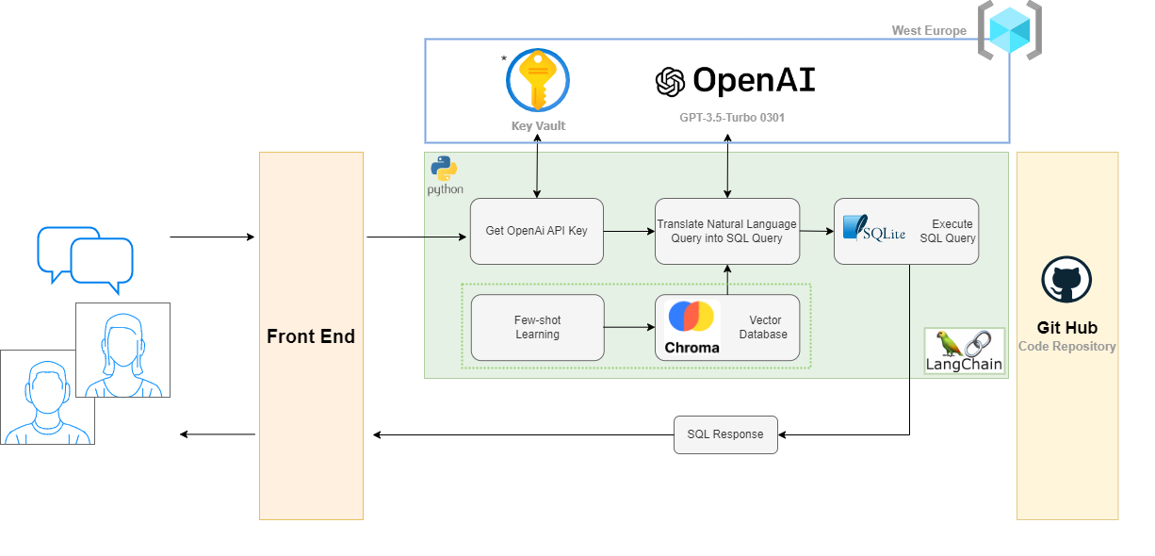
ARCHITECTURE Azure - “Phase 0.5”
The goal of LangChain is to link powerful LLMs, such as OpenAI's GPT-3.5, to an array of external data sources to create and reap the benefits of natural language processing (NLP) applications.
ChromaDb is an open-source vector database that will be used to store our embeddings. A vector database in an NLP project helps in efficiently querying and analyzing the high-dimensional vector representations of words which are fundamental to many NLP tasks. In an Azure environment, we can replace this service with Azure AI Search since it’s the oficial service from Azure but implies a cost.
SQLite library to host the data in an embedded database. Our first suggestion was to use SQL Database since it’s the best tool to host in data in Azure for this use case, however, to avoid dependencies with other teams and for this first stage of the project, we’ll use SQLite, assuming that it can’t support large amounts of data.
To create our resource group, we’ve chosen the West Europe region since it’s one of the regions allowed by EPO to use and we wen can deploy OpenAI service with GPT-3.5-Turbo (0301). This region constraint take us to chose the oldest model for GPT-3.5-Turbo. Important to know that this model has a limitation of 4,096 per request.
* Although Key Vault is not strictly mandatory, it is highly recommended to store sensitive data as credentials or db connections

Slide 6
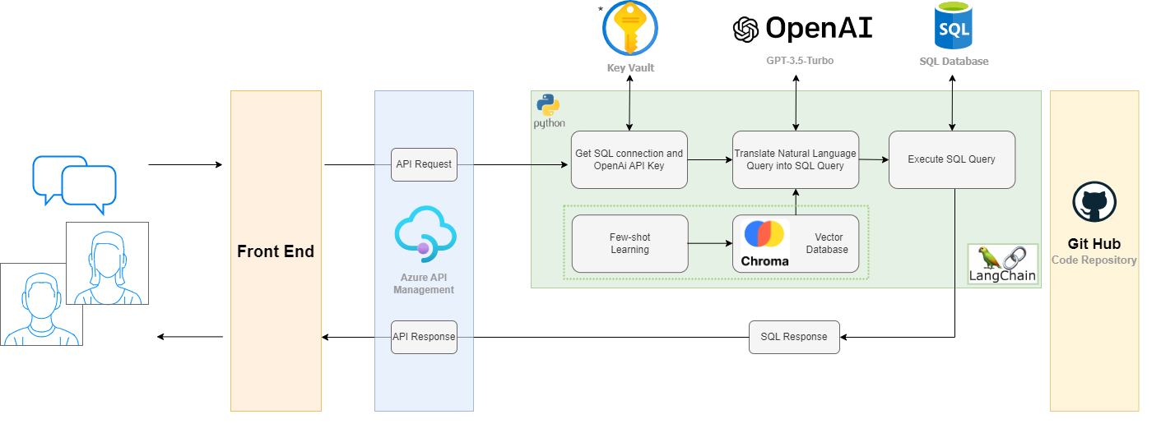
ARCHITECTURE Azure – Phase 1
The goal of LangChain is to link powerful LLMs, such as OpenAI's GPT-3.5, to an array of external data sources to create and reap the benefits of natural language processing (NLP) applications.
ChromaDb is an open-source vector database that will be used to store our embeddings. A vector database in an NLP project helps in efficiently querying and analyzing the high-dimensional vector representations of words which are fundamental to many NLP tasks. In an Azure environment, we can replace this service with Azure AI Search since it’s the oficial service from Azure but implies a cost.
A SQL Database can be replaced by the SQLite library to host the data when dealing with a single table. However, for a production project, a SQL database is strictly necessary.
* Although Key Vault is not strictly mandatory, it is highly recommended to store sensitive data as credentials or db connections

Slide 7
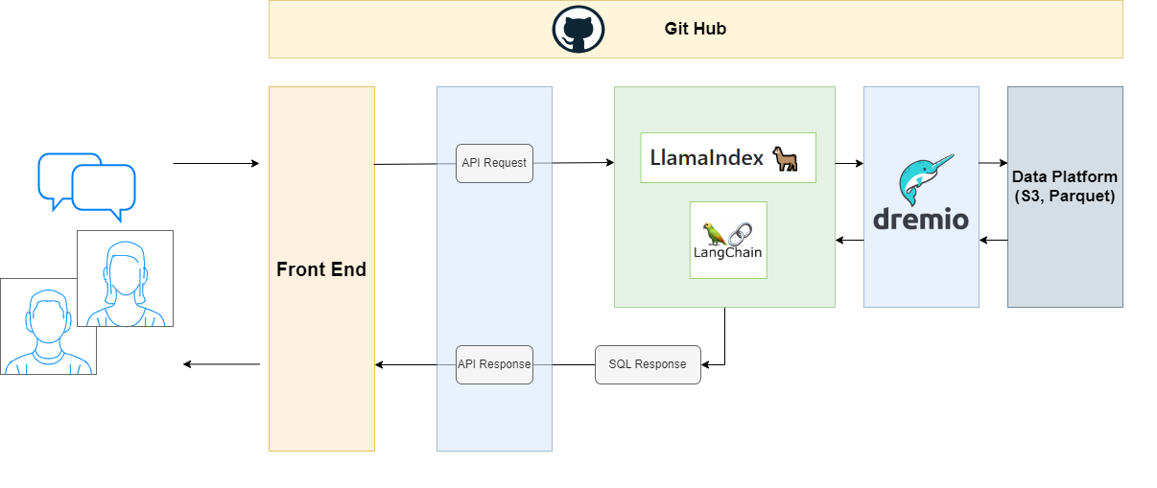
ON-PREM Arch

Slide 8
Agregar las librerías y una pequeña descripción de la funcionalidad.

Slide 9
2. Risks and dependencies
Risk description | Likelihood | Impact | Severity | Owner | Mitigation
Suggested API service doesn't meet our requirements or there is another service that is more suited for our use case | Medium | High | High | Developers | Cloud Run is another service that may meet our needs and fits well into our CGP architecture
Suggested architecture does not follow EPO standards | Medium | High | High | Internal architects | Agree on the key components on our architecture with EPO
SQLite is enough to allocate all the data we want for this first stage of the POC | Medium | High | High | Developers – Internal architects | Reduce the amount of data in SQLite
 |  |  |  |  | Go for our initial approach where SQL Database is used, assuming the delay of managing the deployment of the service from an EPO team
GPT-3.5-Turbo (0301) doesn’t meet our requirements due to token limitation | Low | High | Medium | Developers – Internal architects | We must request a resource group allocated in another region than West Europe And West Central Germany, as an exception for this POC, since these two standard regions for EPO don’t have a better model than GPT-3.5-Turbo (0301)
 | Risk Matrix | Severity
Probability | Impact | Low (0-25%) | Moderate (26-50%) | High (51-75%) | Extreme (76-100%)
 | Low (0-25%) | 0 | 0 | 0 | 0
 | Moderate (26-50%) | 1 | 0 | 0 | 0
 | High (51-75%) | 1 | 0 | 1 | 0
 | Extreme (76-100%) | 0 | 0 | 0 | 1
* Impact calculation matrix
9

Slide 10
Annex

Slide 11
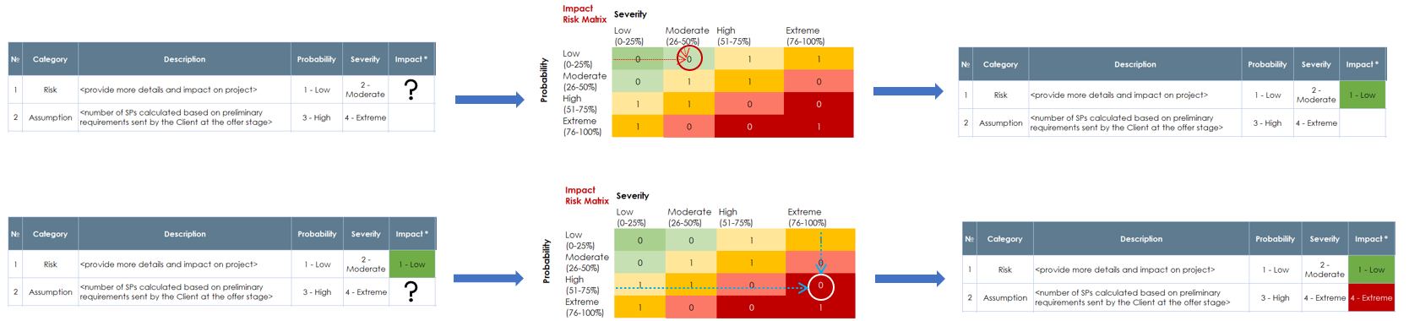
Annex 7. Impact calculation examples
 | Risk Matrix | Severity
Probability | Impact | Low (0-25%) | Moderate (26-50%) | High (51-75%) | Extreme (76-100%)
 | Low (0-25%) | 0 | 0 | 0 | 0
 | Moderate (26-50%) | 1 | 0 | 0 | 0
 | High (51-75%) | 1 | 0 | 1 | 0
 | Extreme (76-100%) | 0 | 0 | 0 | 1
Back to Risks & Dependencies
11

Slide 12
Merci / Vielen Dank / Thanks!

